Slide 1

EventList
What the log?! So many events, so little time...
Miriam Wiesner

Slide 2


Miriam Wiesner
Security Program Manager for Microsoft Defender ATP
@miriamxyra
https://miriamxyra.com
miriam.wiesner@microsoft.com

Slide 3
Disclaimer
This presentation and the tool demonstrated during the session is my personal work and not supported by Microsoft.

Slide 4
Typical Attack Timeline & Observations
Domain Admin Compromised
First Host Compromised
Attack Discovered
Research & Preparation
Attacker Undetected (Data Exfiltration)
24-48 Hours
More than 200 days (varies by industry)

Slide 5


Identity is the new security “perimeter” under attack
Active Directory and Administrators control all the assets
Browsing
Attackers Can
Steal any data
Modify documents
Impersonate users
Disrupt business operations
Azure Active Directory
Active Directory
One small mistake can
lead to attacker control

Slide 6
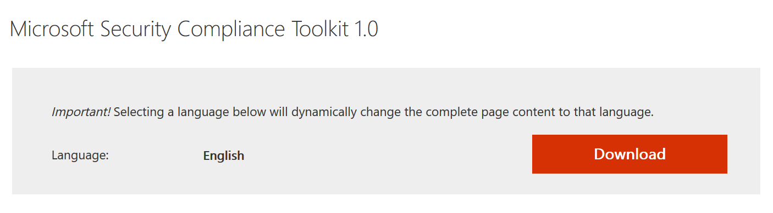
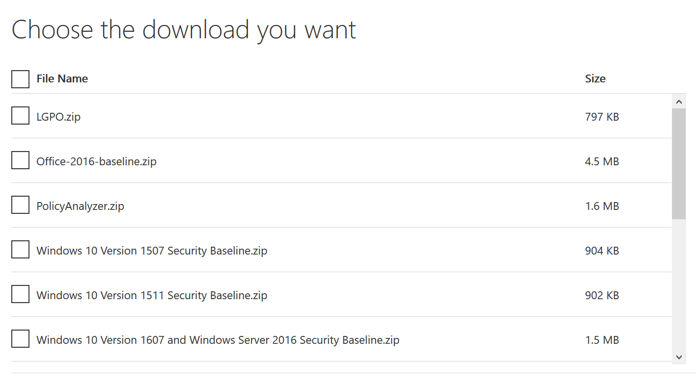
Microsoft Security Compliance Toolkit
https://aka.ms/SCT

Slide 7
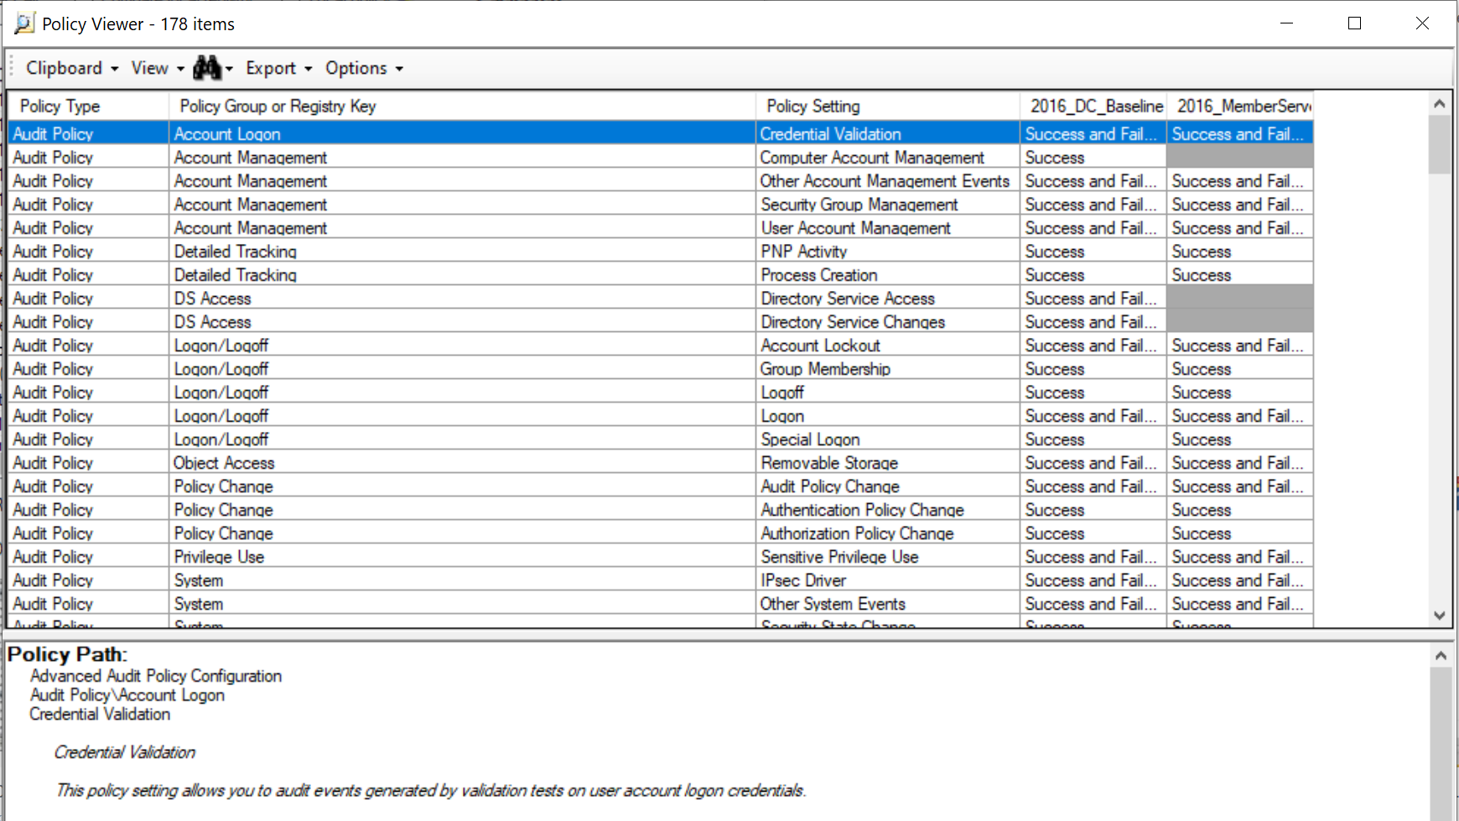
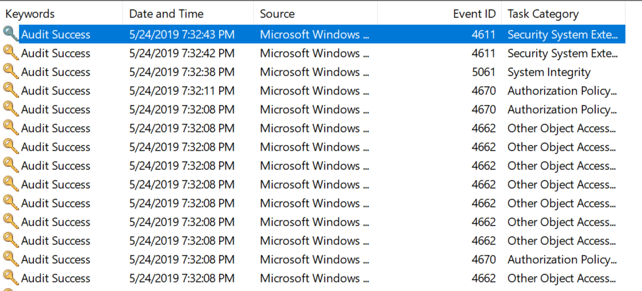

Slide 8


Slide 9


Slide 10
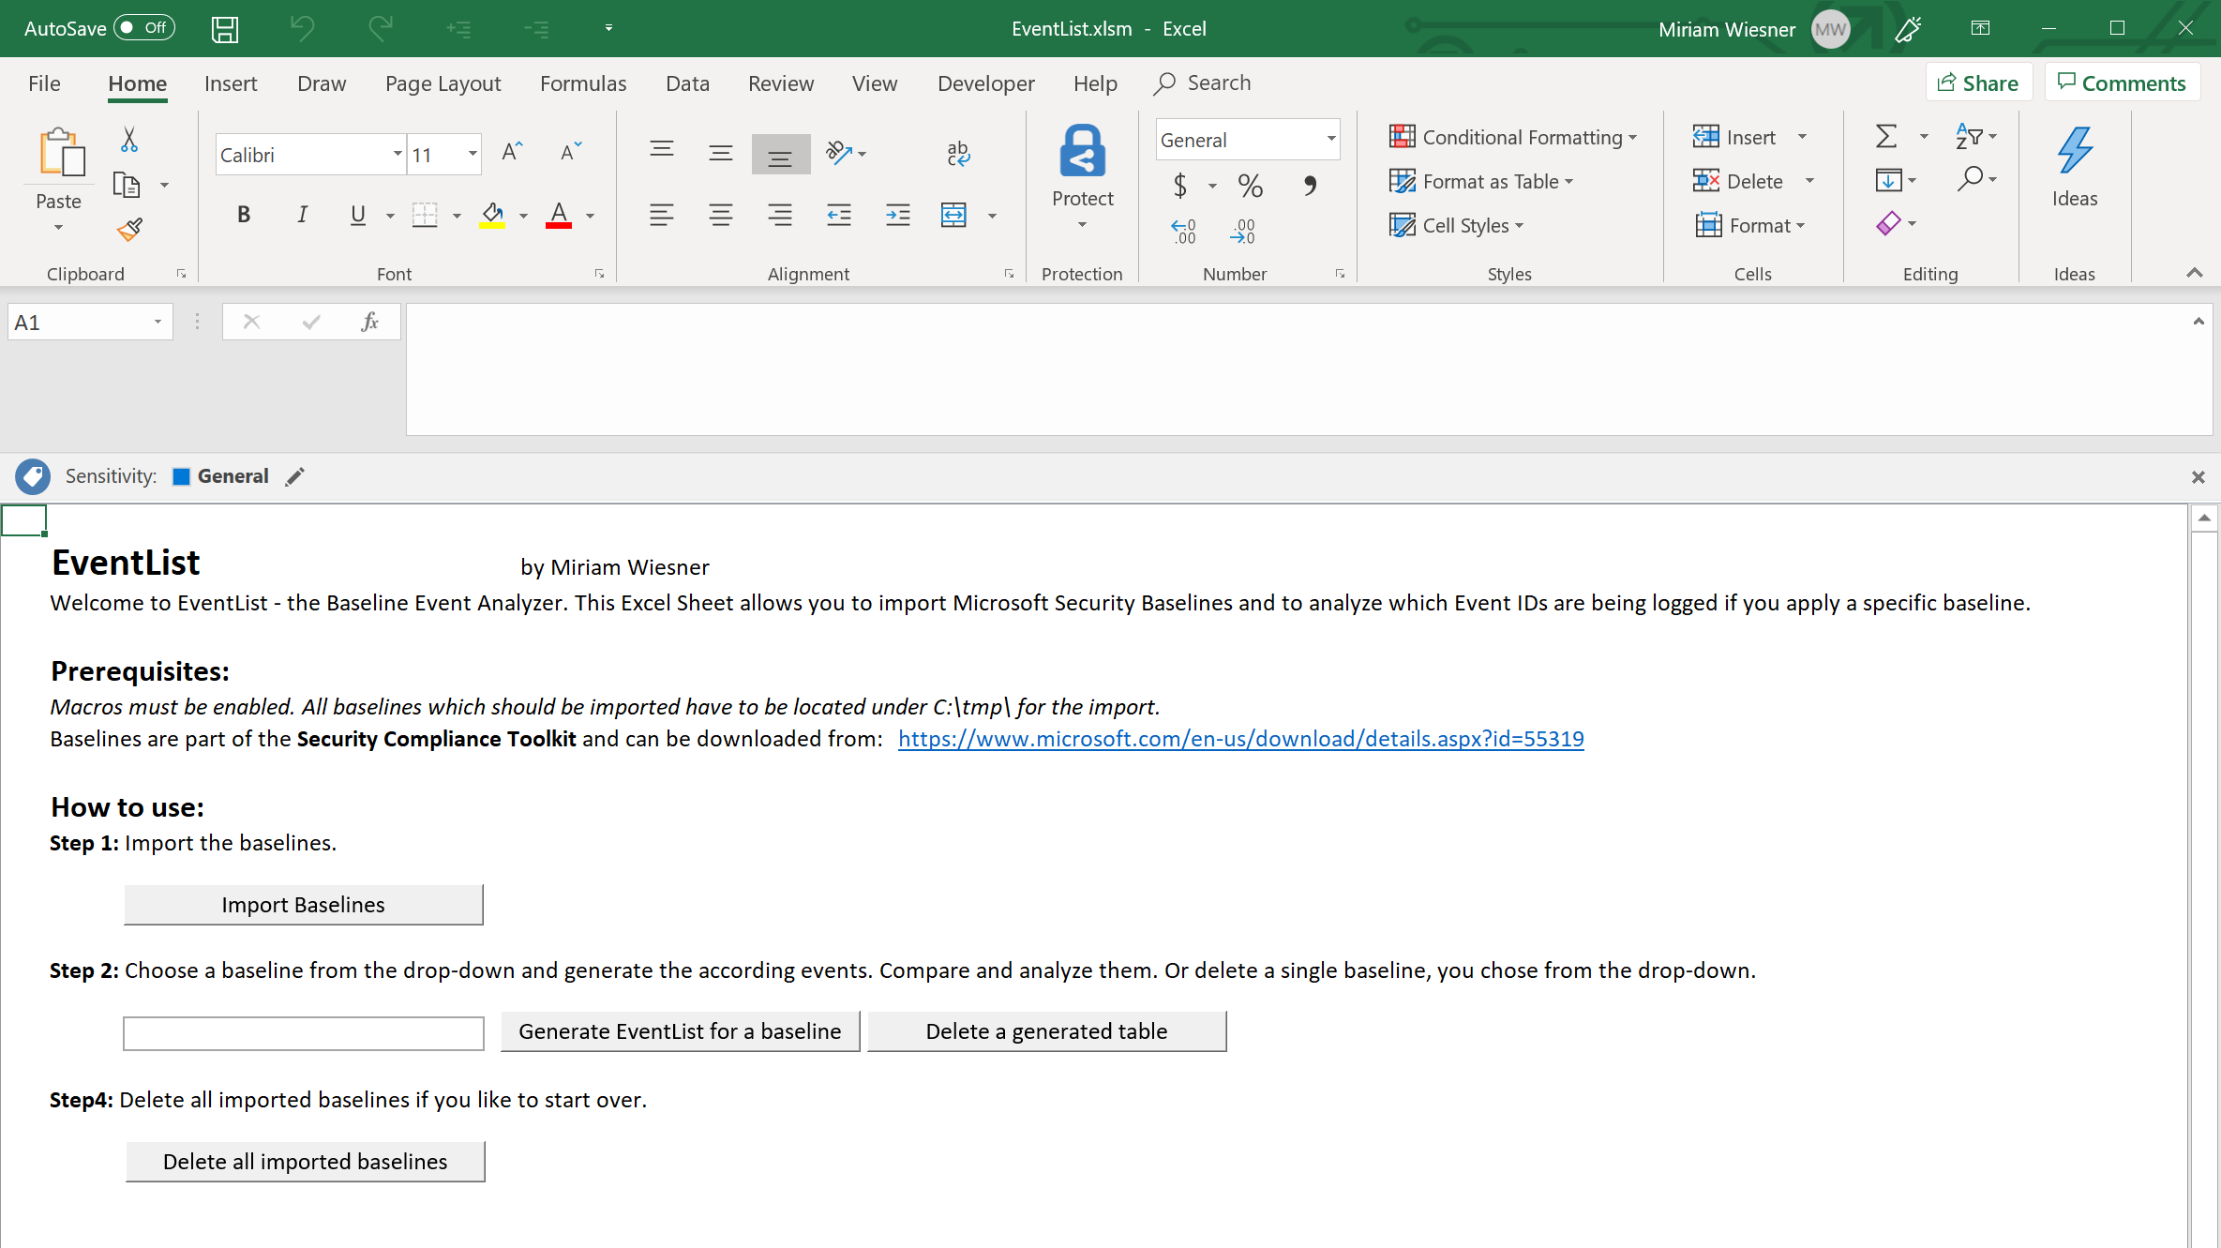
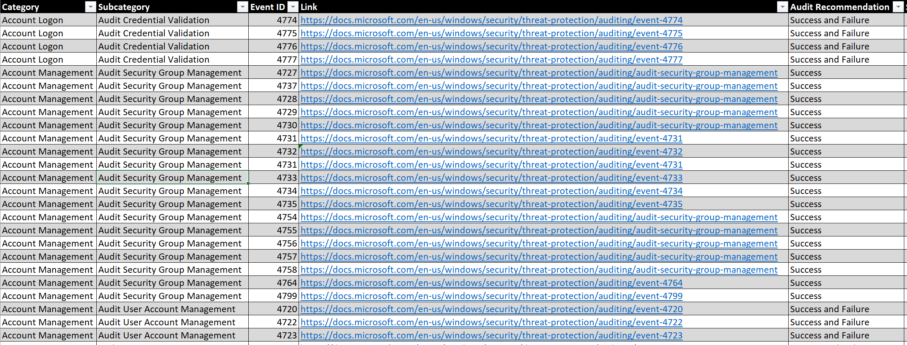
EventList 1.0

Slide 11
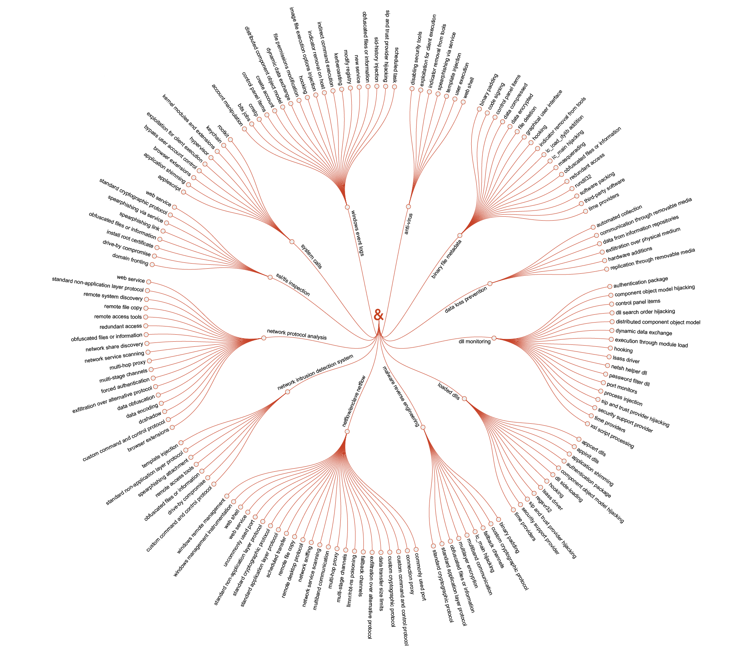
MITRE ATT&CK
Impact
Execution
Initial Access
Credential Access
Persistence
Privilege Escalation
Defense Evasion
Lateral Movement
Discovery
Exfiltration
Command and Control
Collection
Notes:
Techniques mapped to Data Sources

Slide 12
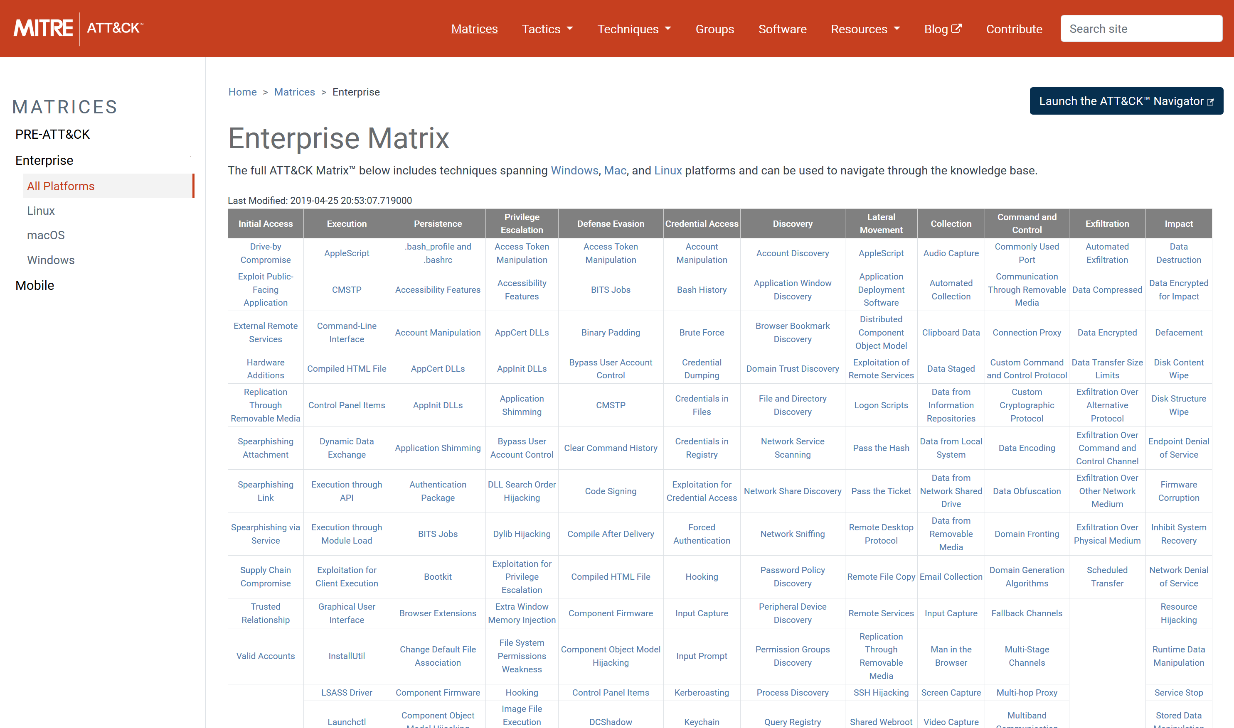
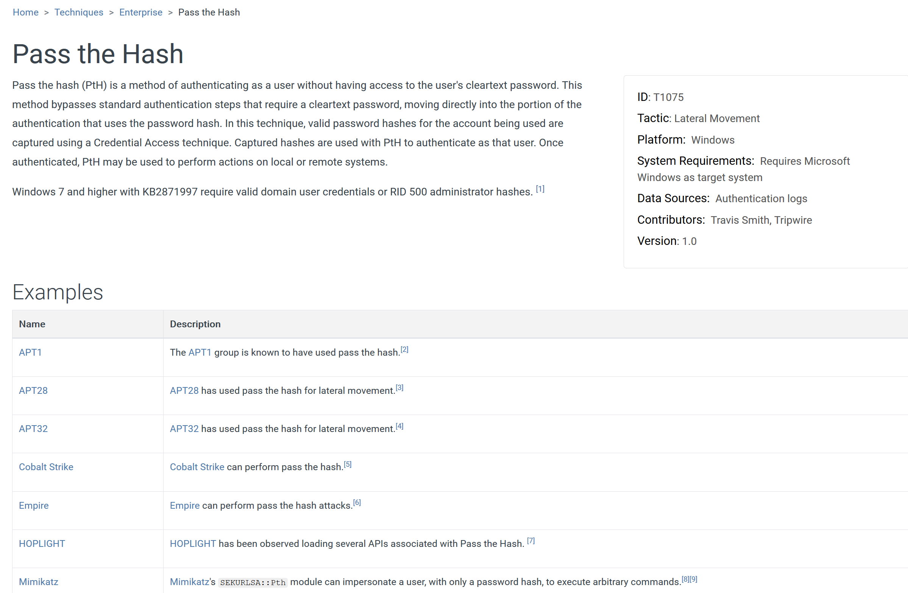

Slide 13
MITRE ATT&CK
Impact
Execution
Initial Access
Credential Access
Persistence
Privilege Escalation
Defense Evasion
Lateral Movement
Discovery
Exfiltration
Command and Control
Collection
Notes:
Techniques mapped to Data Sources

Slide 14
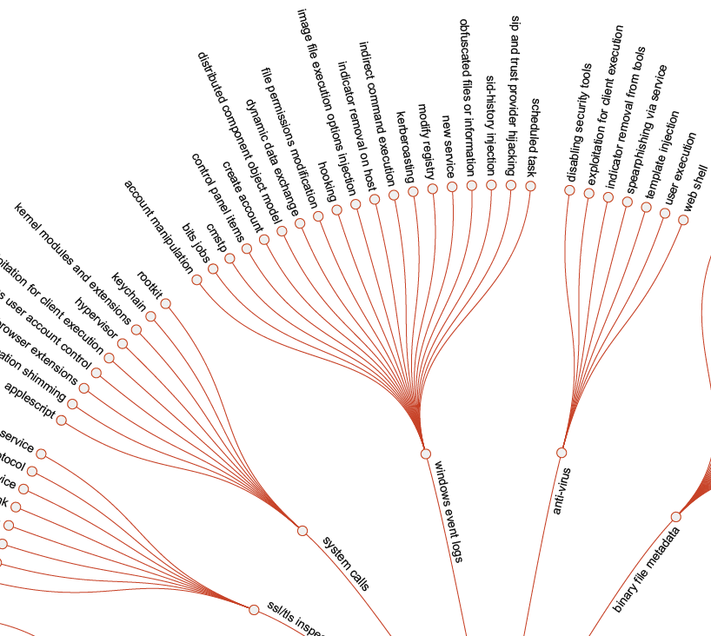

Slide 15

Hunting queries?
Which events should be forwarded?
Which events will be generated?

Slide 16
DEMO

Slide 17

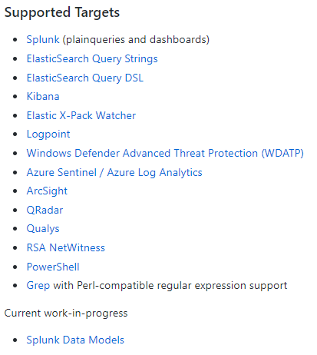
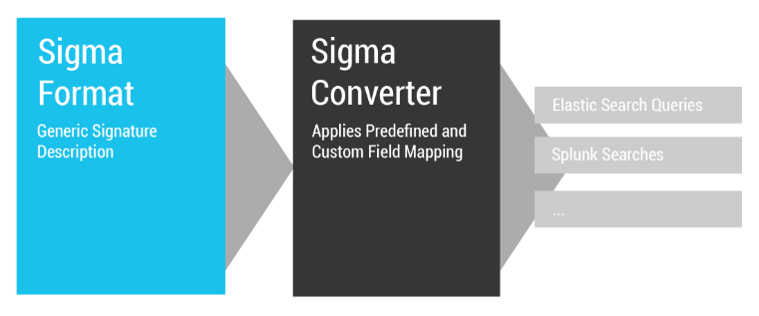
https://github.com/Neo23x0/sigma

Slide 18
Contribute to EventList
Are you interested in contributing to EventList...
...to improve it?
...to implement new features?
...to implement cross-platform support?
What are your ideas and suggestions for EventList?
GitHub: https://github.com/miriamxyra/EventList
Create a Pull Request for the „development branch“
Contact me:
@miriamxyra
miriam.wiesner@microsoft.com

Slide 19
Thank you!
Follow me on Twitter: @miriamxyra
https://miriamxyra.com

